Slide 1
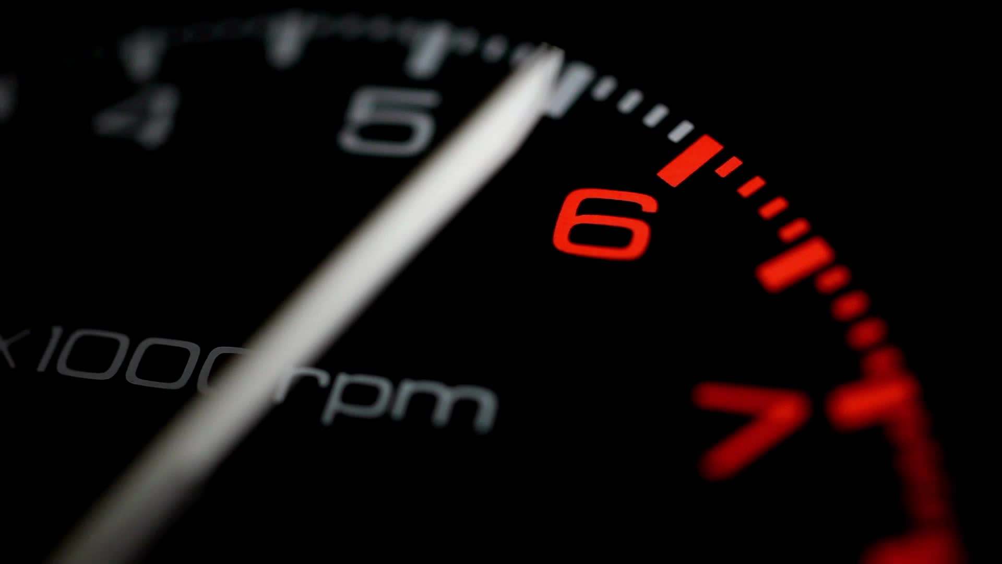
Time Converter
By Joseph Bowling

Slide 2
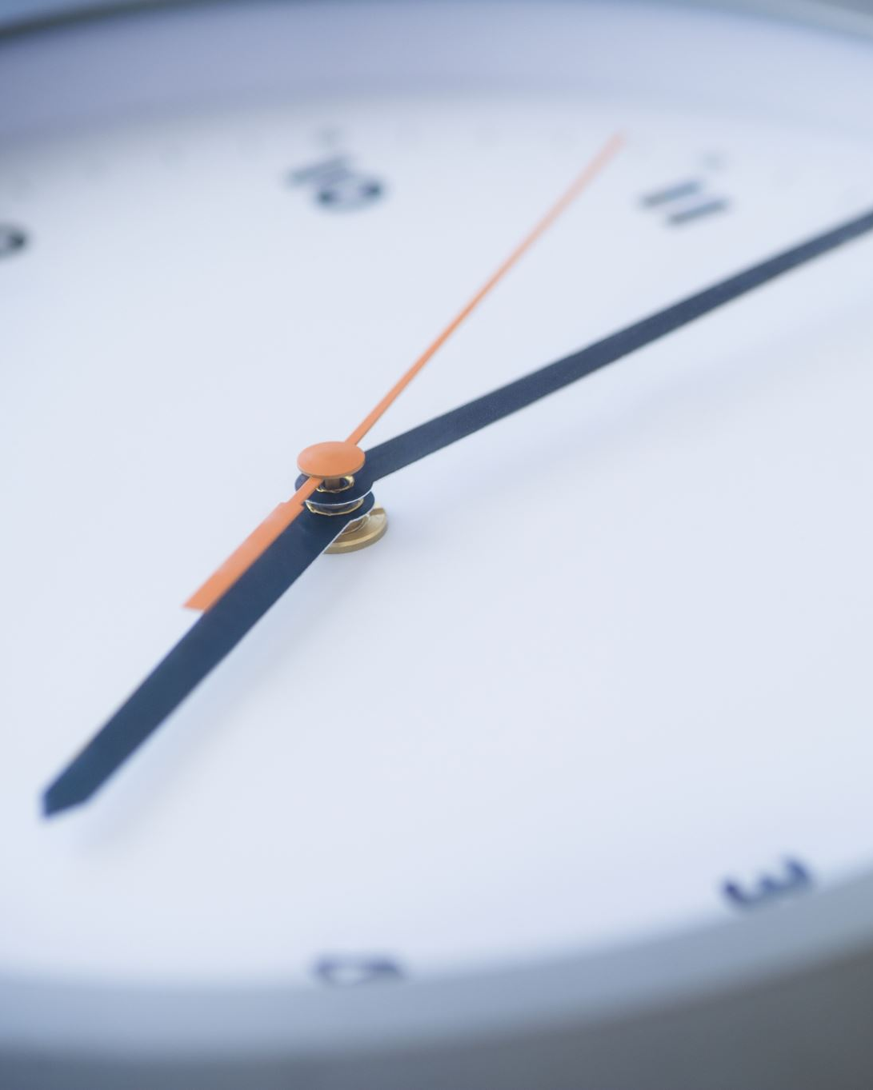
What Is The Time Converter?
The Time Converter is a basic program that converts a given digital time to an analog display.
It works the same on both a 12- and 24-hour time system.

Slide 3

What Is Its Purpose?
With the widespread use of and reliance on digital clocks, there are some who might not know how to read analog clocks or might have trouble reading them.
Additionally, some people might have trouble visualizing what a 24-hour clock would look like.
This program is designed to help users read an analog clock by either converting the system’s current time or a time selected by the user.

Slide 4

How Does It Work?
Simply enter the hour, minute, and second value, and then press the button labeled Convert Time.
Alternatively, selecting the Convert Current Time button will display the current time as an analog display.

Slide 5

What Did I Learn?
More about how JavaFX works
Problem solving

Slide 6
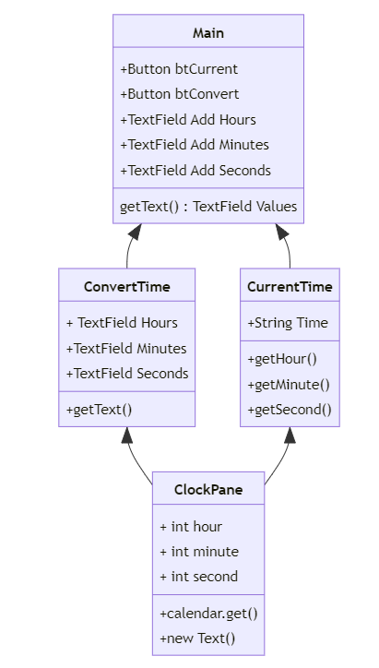
UML Diagram

